Slide 1
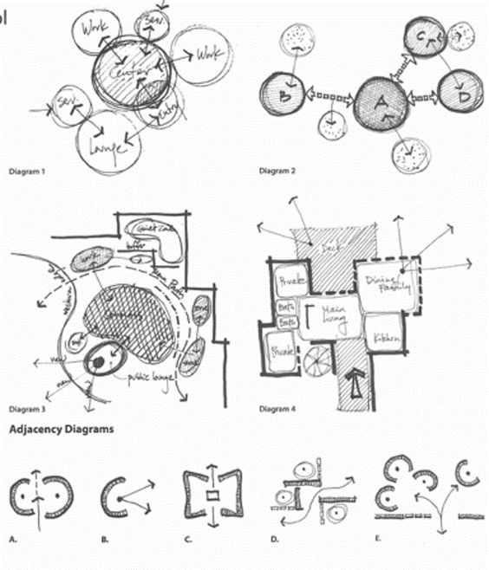

SPACE DESIGNERS WITH PRECISION

Slide 2

DESIGN HARMONY
ENVIOREMNTAL INTREGRATION
EXECUTION
LAYOUT PRECISION
TABLEAU
DELINEATE
INTERIOR SYNERGY
ARCHITECTURAL DETAILING
EXTERIOR PLANNING
NUANCED AESTHETICS

Slide 3
DEFINITION
Describing and portraying concepts with precision.
WHO ARE WE
Delineate is a creative agency which believes in providing services with complete precision and detail, in synchronization with market trend and keeping clients as our top priority.

Slide 4

WHAT DO WE DO
We provide complete services pertaining to consultation, designing and execution with understanding and development for ourselves and our business contributors.
OUR GOAL
Our clients are the focal center for our work and success, ergo provide inspiration and ability to provide more success stories across the work field.

Slide 5
PROJECTS WE YEILD
Concept designing
Retail Stores design
Fixture design
Residential
Commercial (Hubs)
SERVICE WE OFFER
We create concepts, identities, strategies, retail communication and interior architecture of different formats and categories for different retail brands.
We expertise in Innovating & creating designs, conceptual & schematic ideas by understanding the client’s needs and briefs.
Delivering complete detail drawings, preparing BOQs and managing resources to ensure execution of projects within time and budgeted parameters.

Slide 6
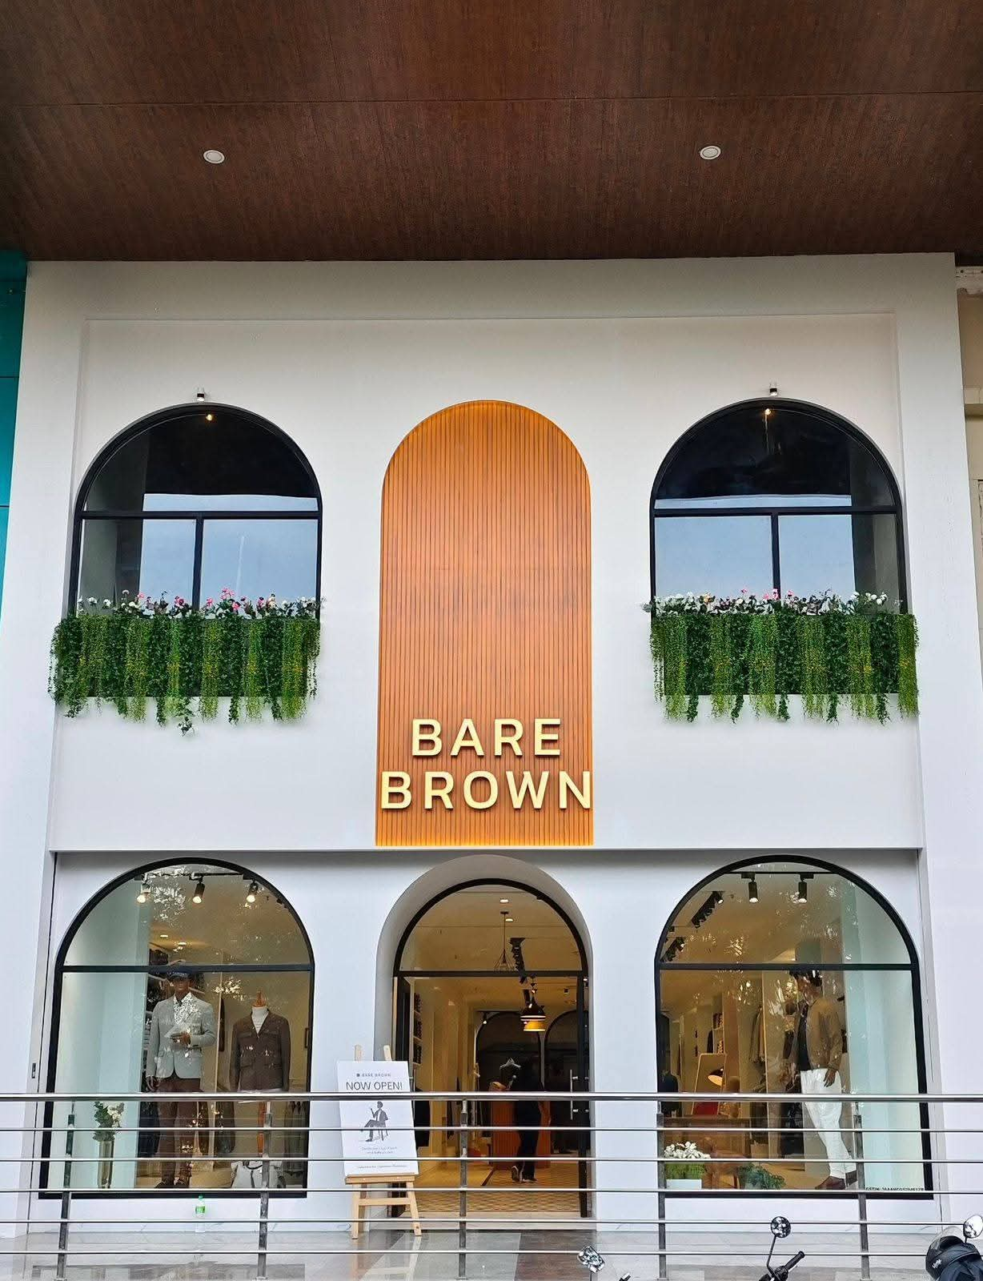
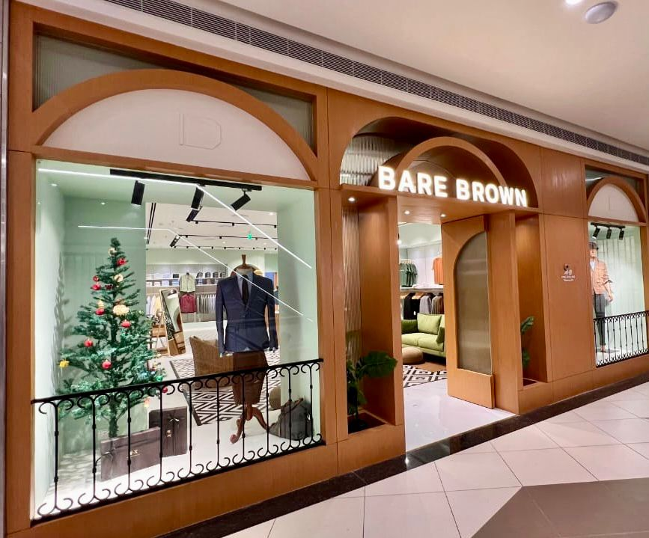
OUR PROJECTS
BARE BROWN
A store, where elegance meets simplicity in a store design that invites you to explore and linger.
The space is a harmonious blend of earthy tones and modern aesthetics, with rich browns, soft neutrals, and warm wood accents that create a welcoming atmosphere.

Slide 7
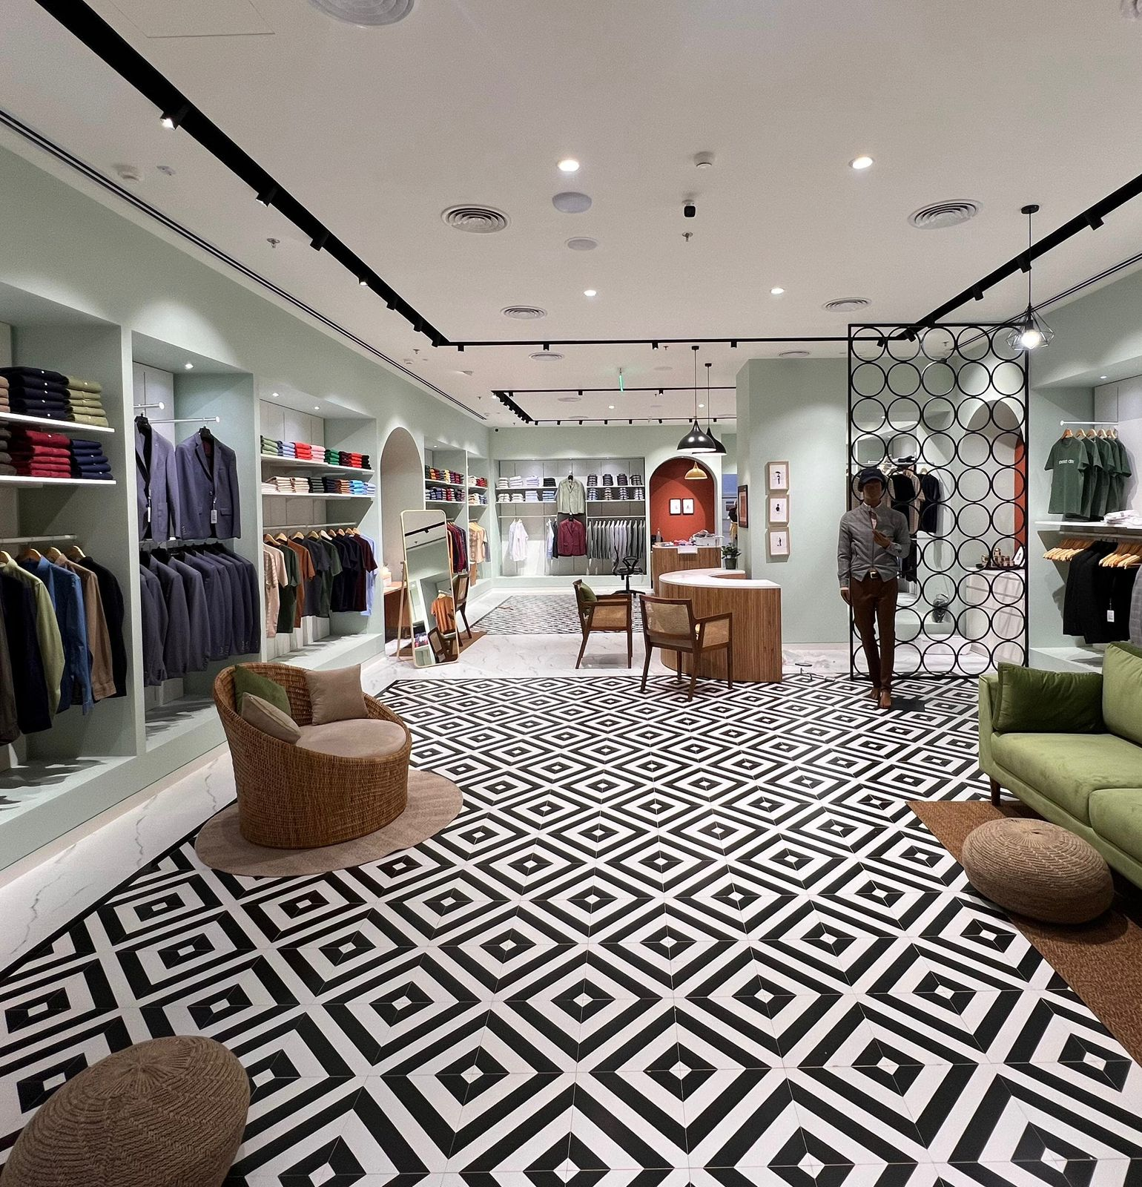
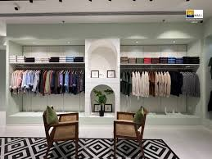
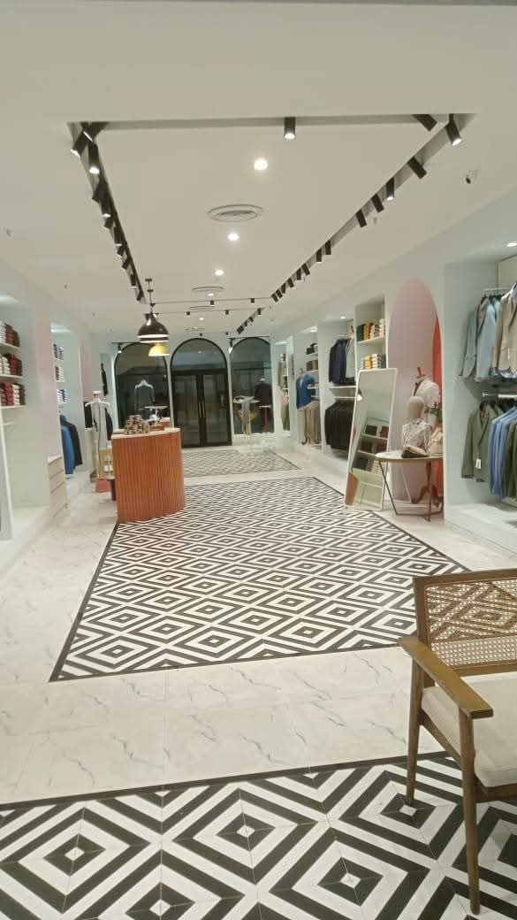
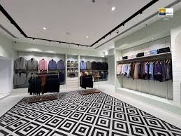
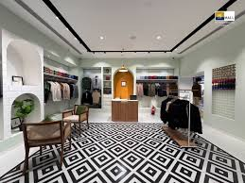
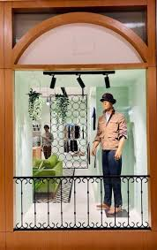
OUR PROJECTS

Slide 8
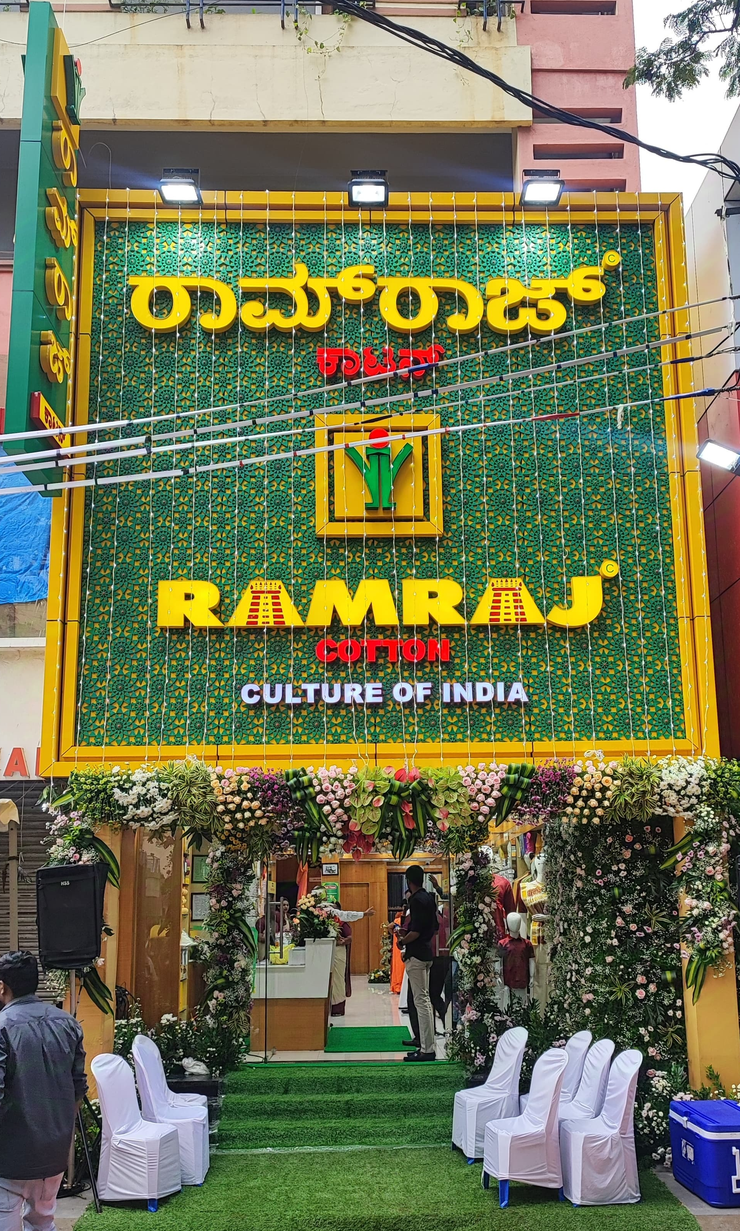
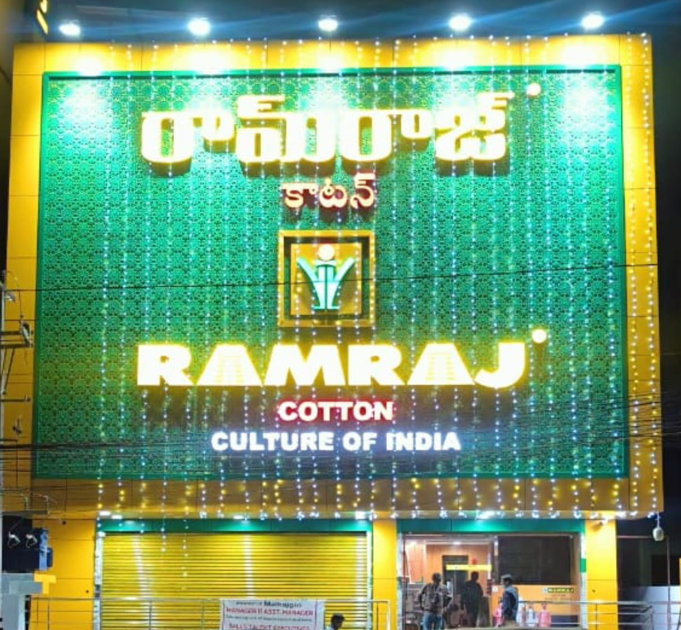
OUR PROJECTS
Ramraj cotton Men and Women apparel store.
A store that revolves and reflects the brands core value simplicity, tradition and authenticity.
Store design blends modern retail layouts with elements and Indian heritage reflecting an organic feel, earthy tone furniture and soft lighting.

Slide 9
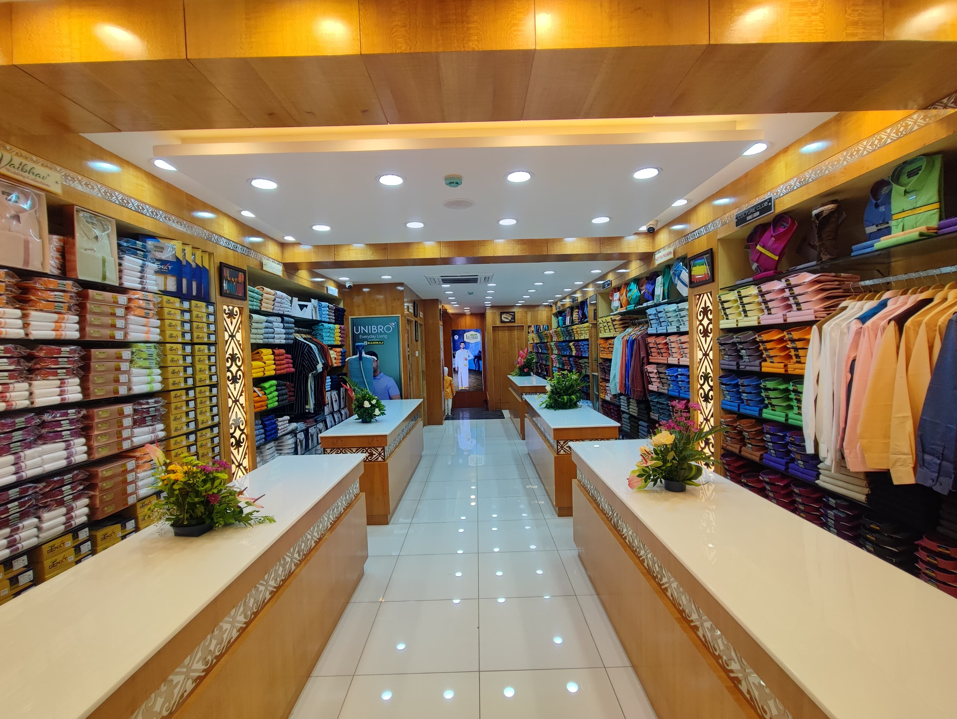
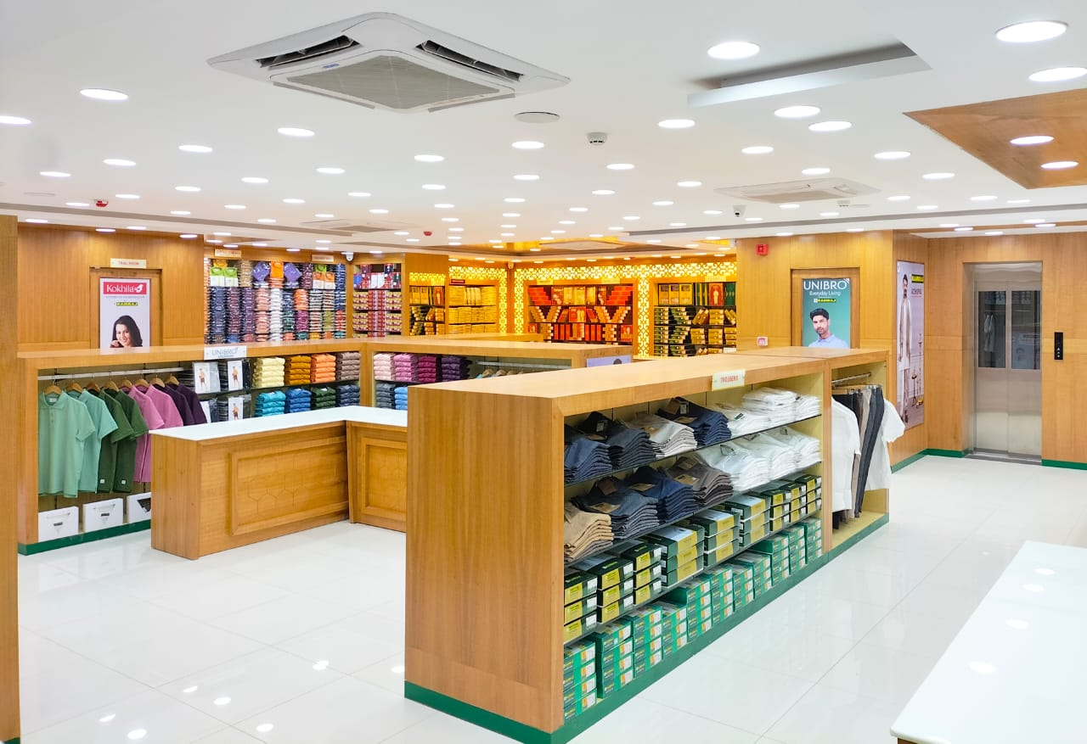
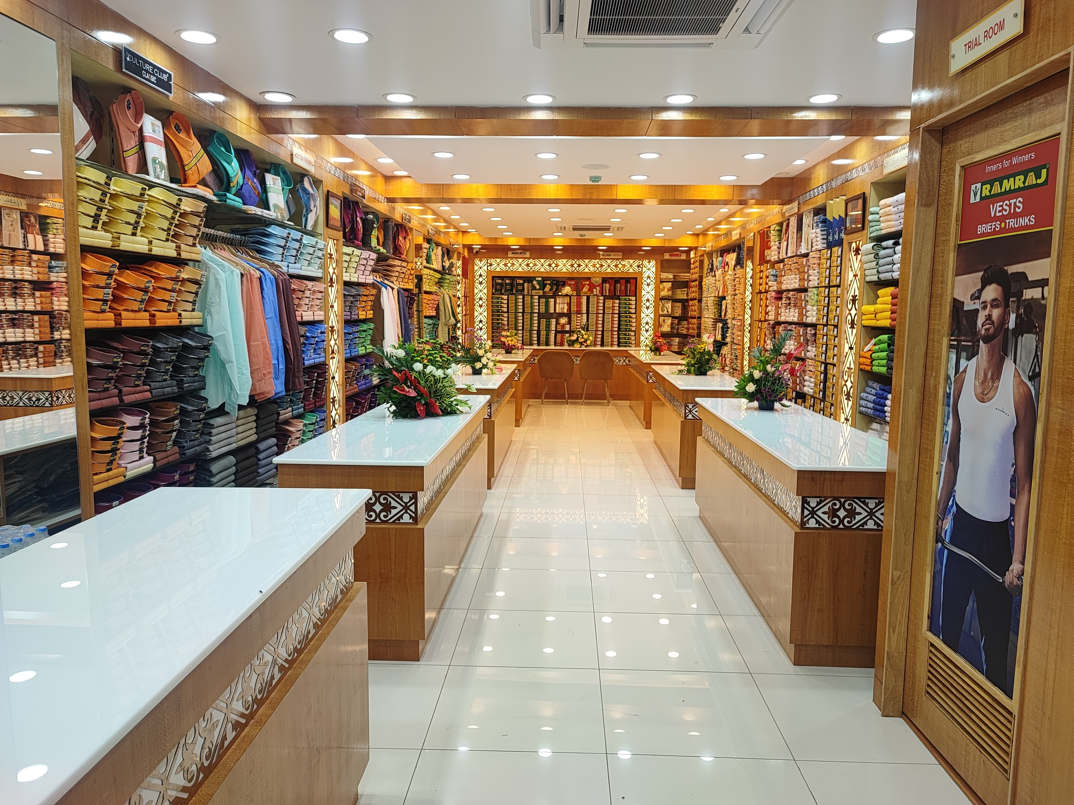
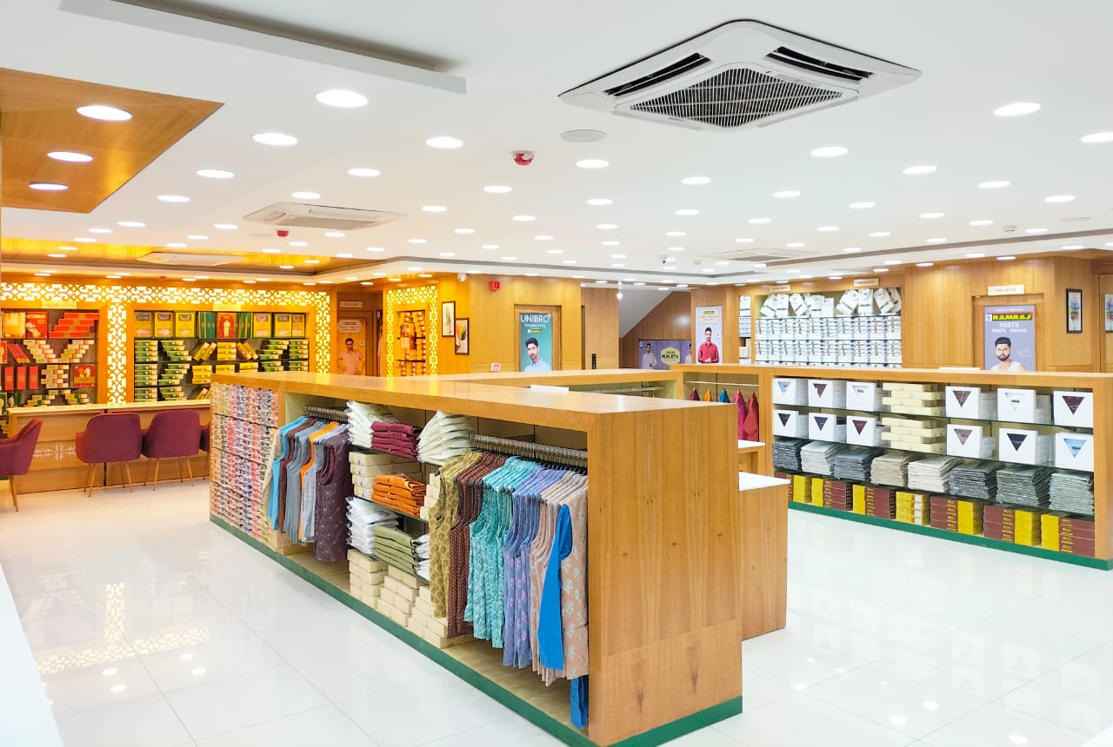
OUR PROJECTS

Slide 10
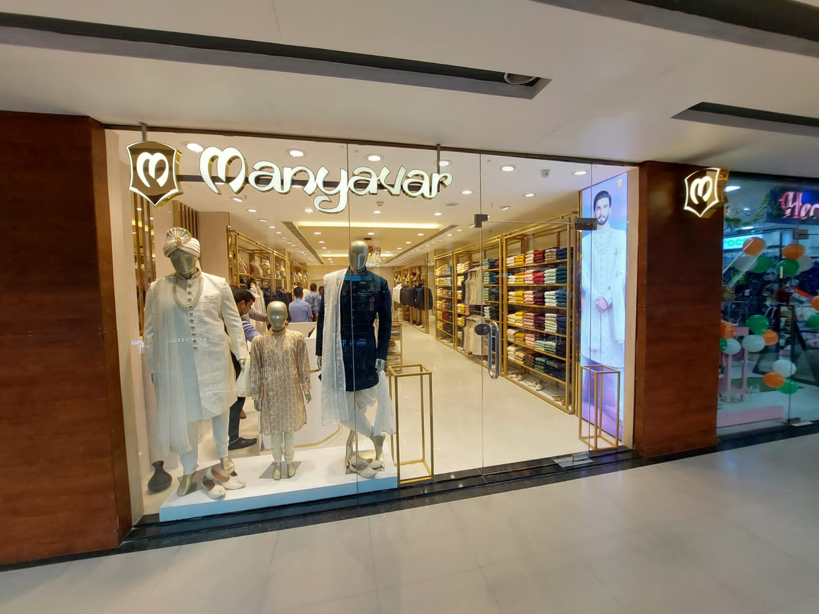
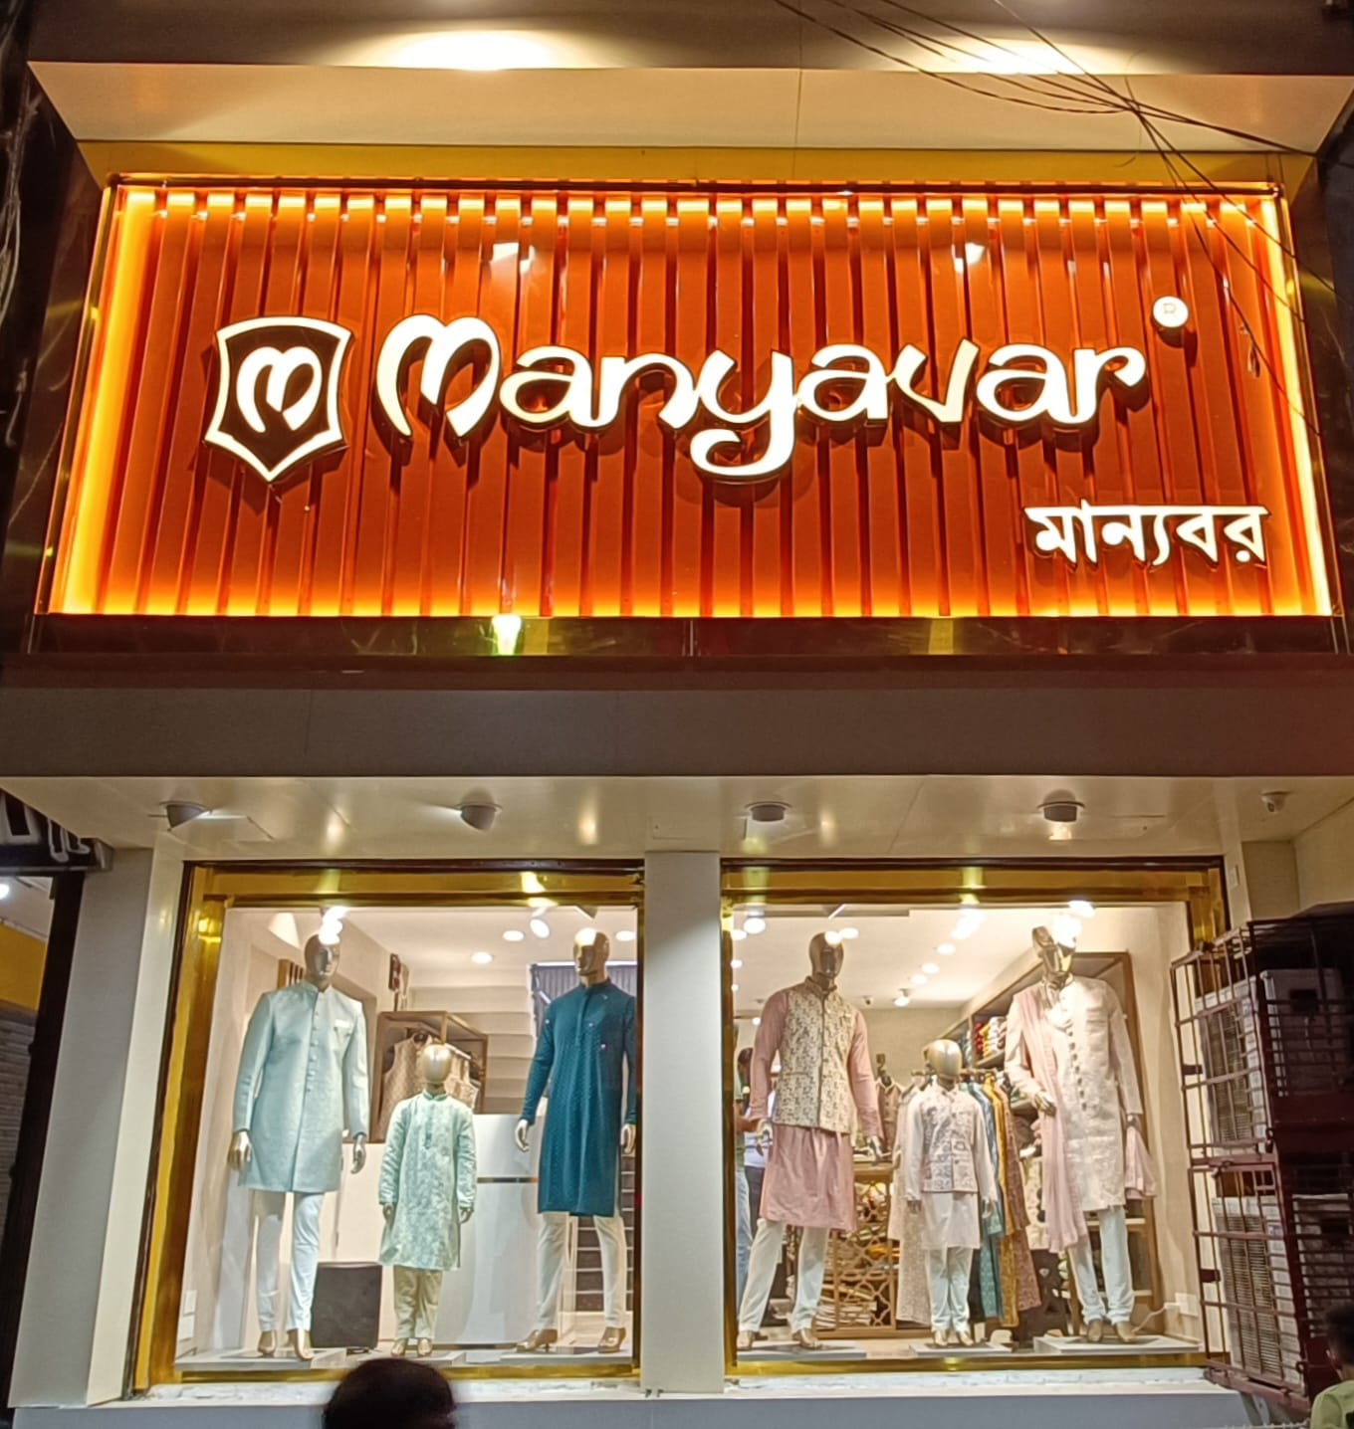
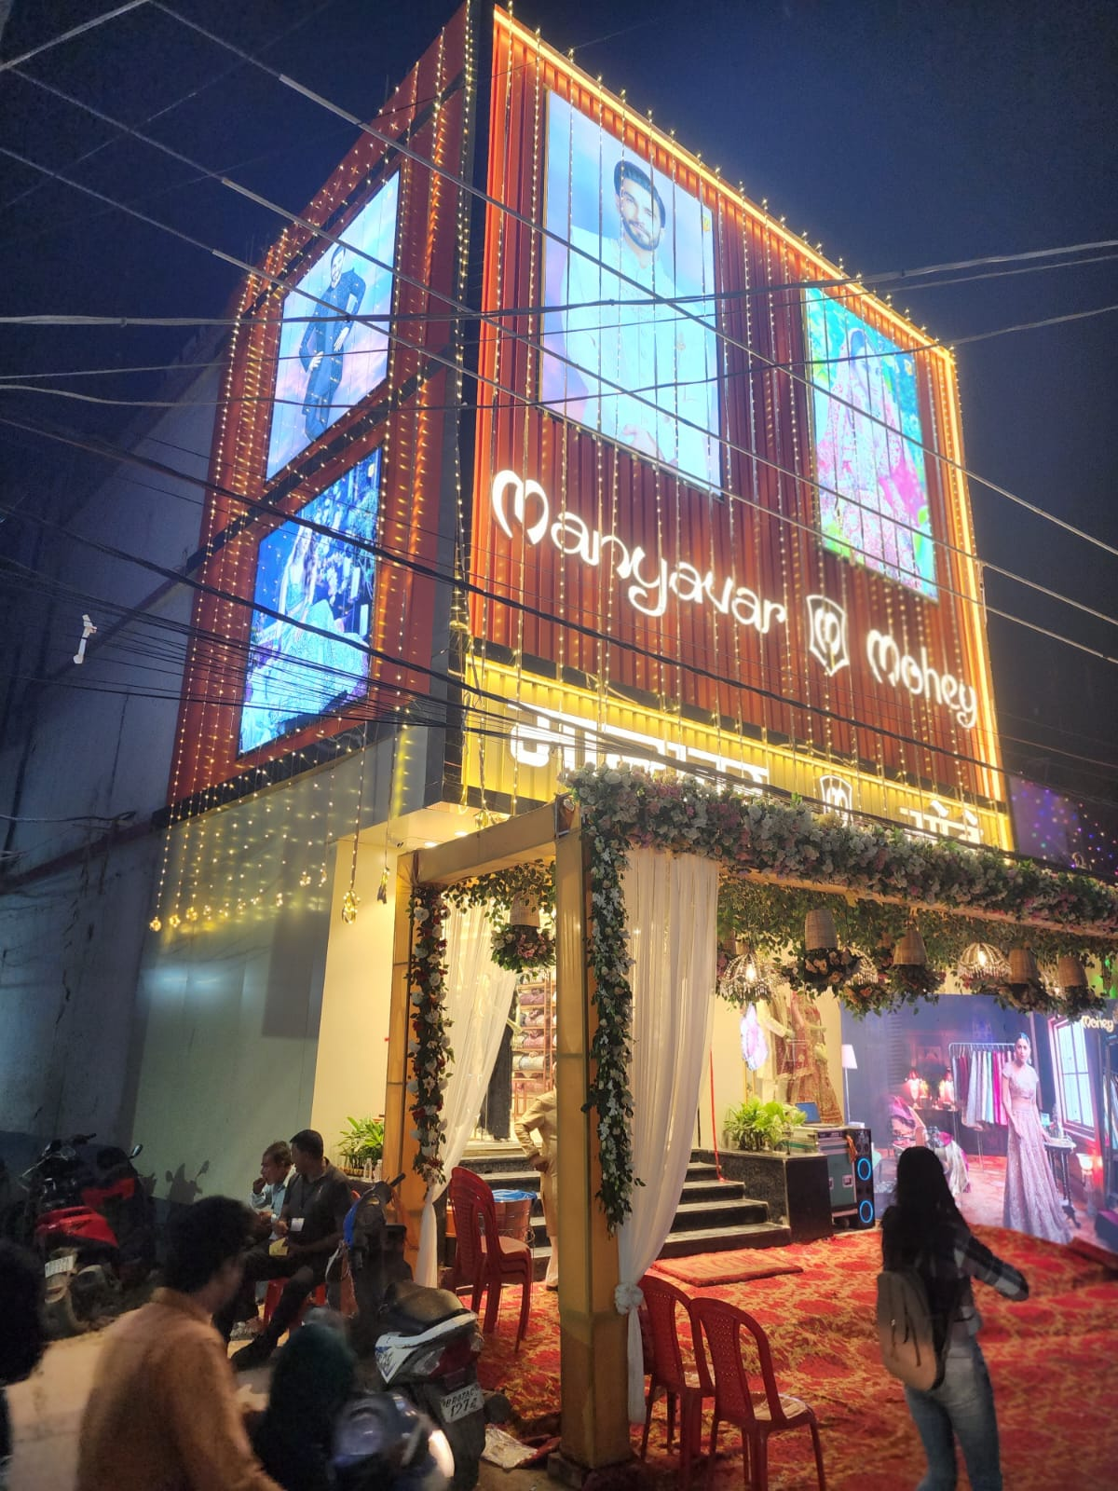
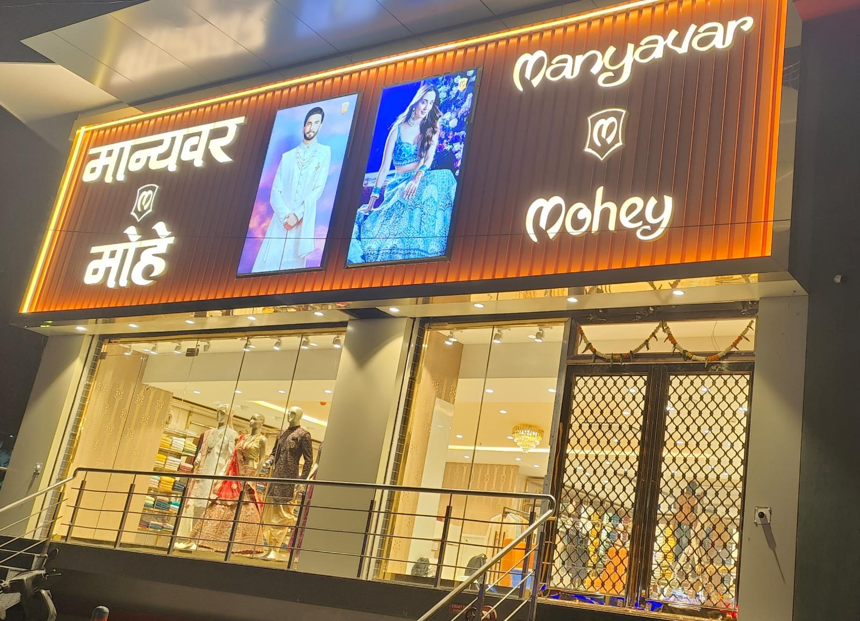
OUR PROJECTS
Manyavar Mohey -Men and Women Ethnic apparel store.
A store space created to include, culture resonant, and reflects the diversity within the target audience.
Authentic materials, patterns, and colors that resonate with the ethnic backgrounds.

Slide 11
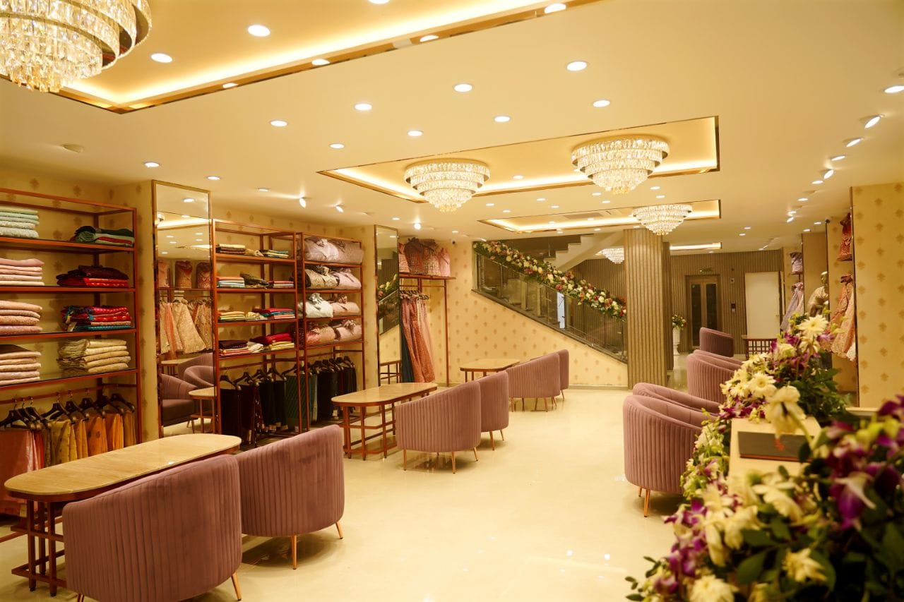
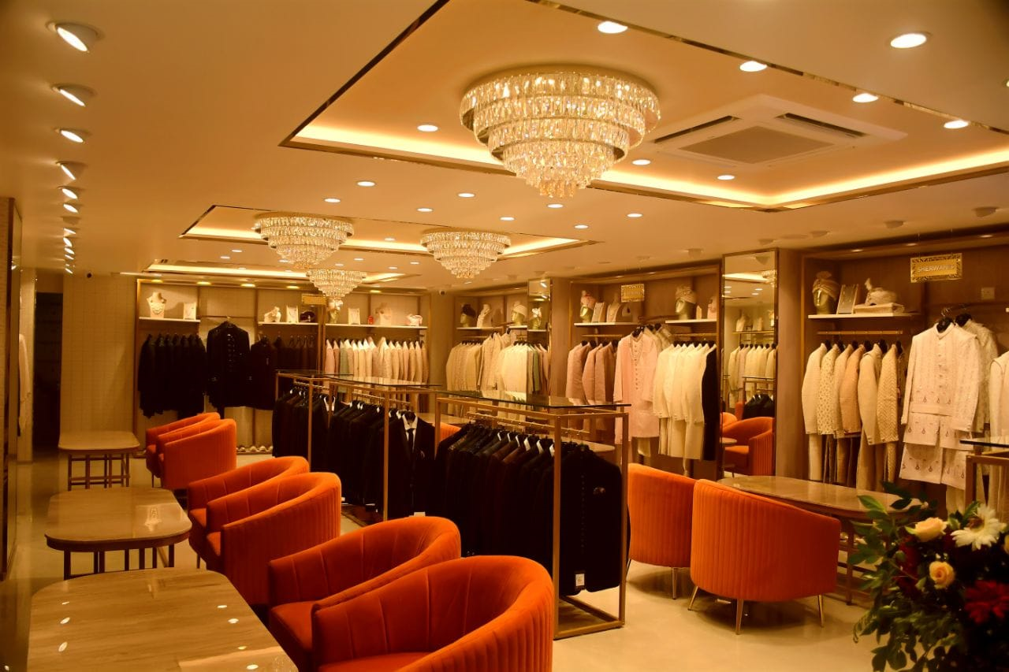
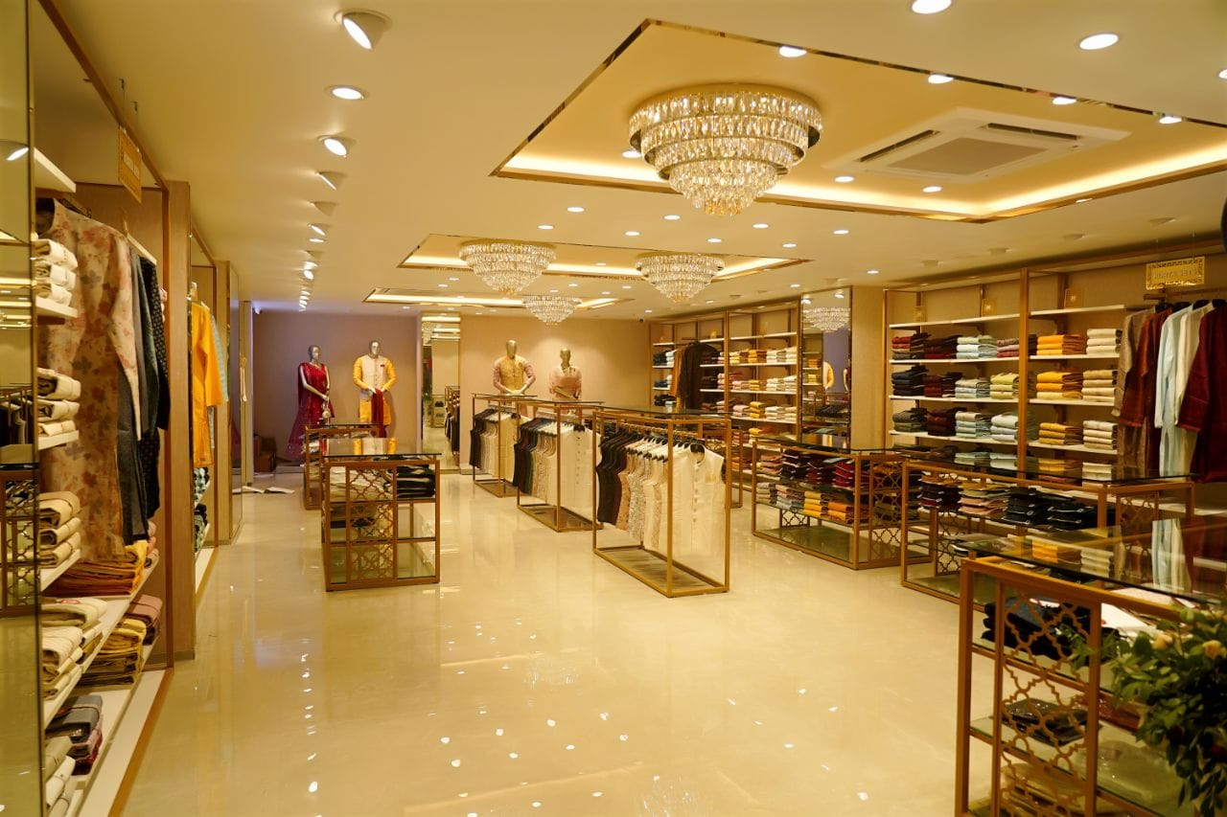
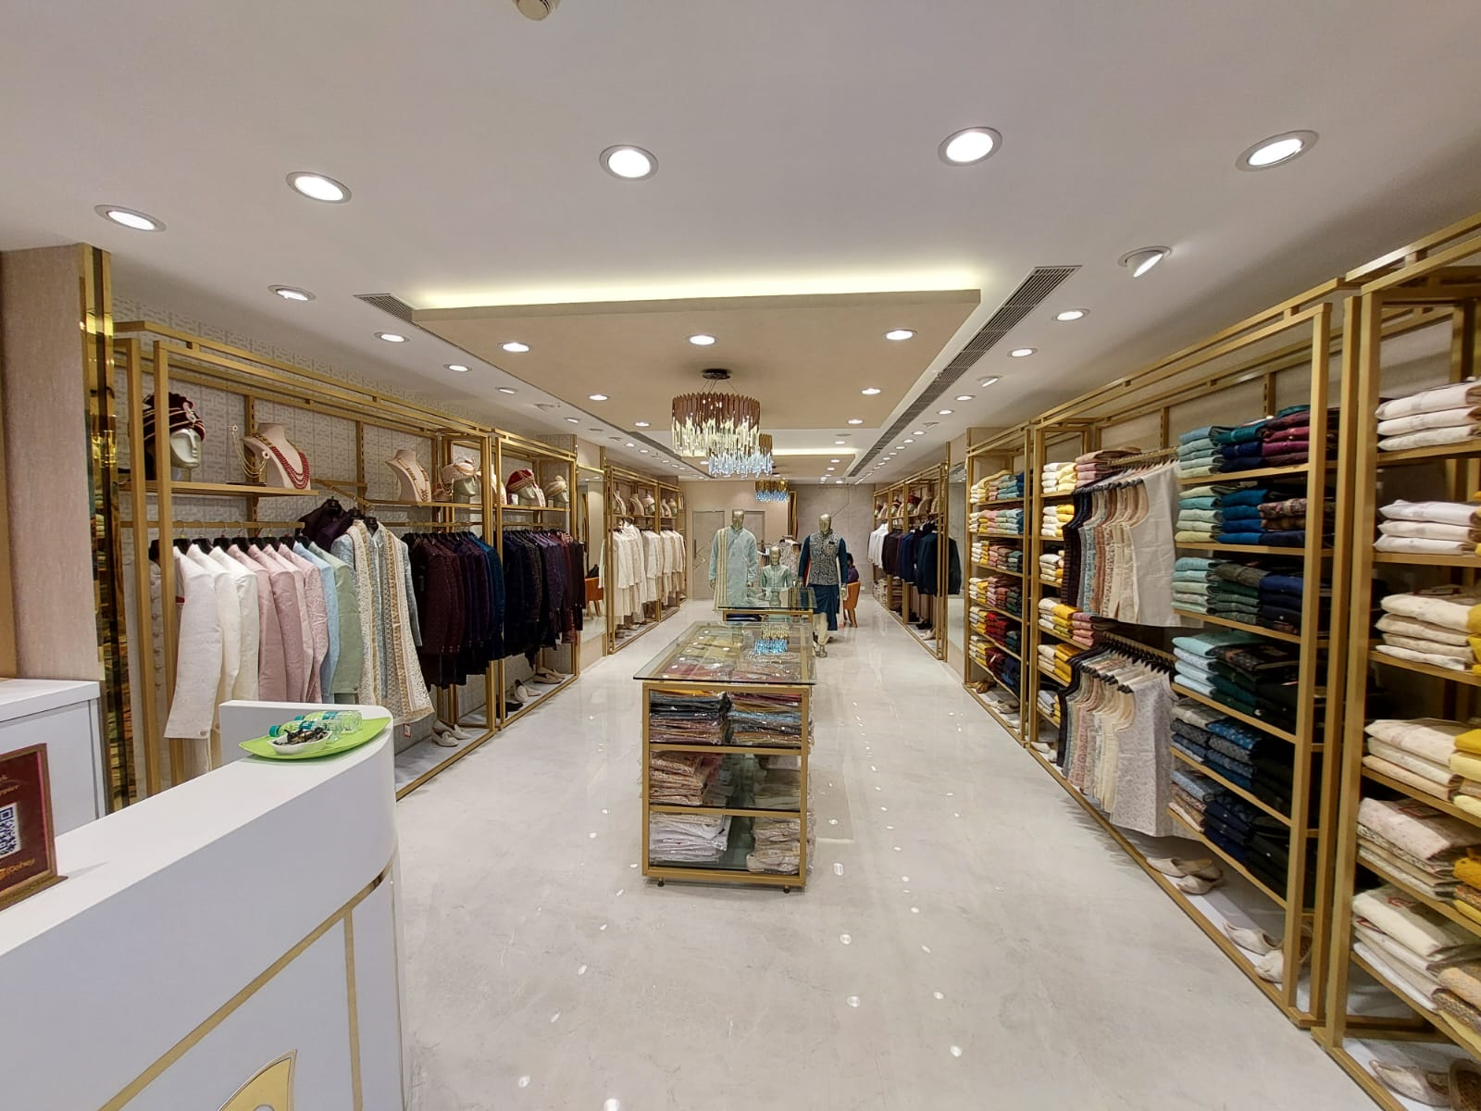
OUR PROJECTS

Slide 12
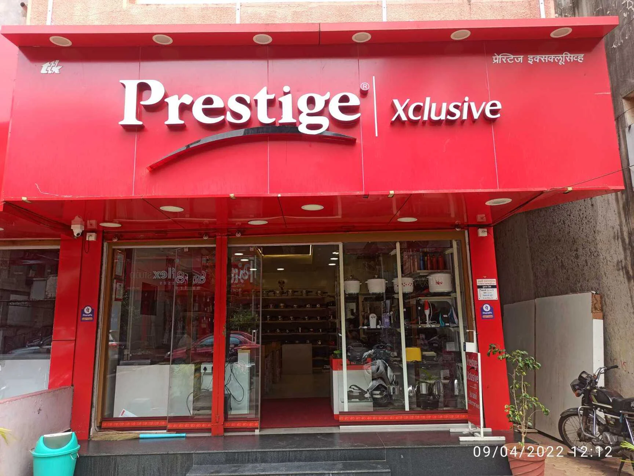
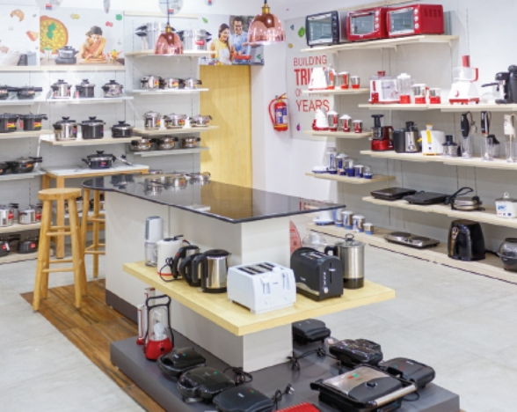
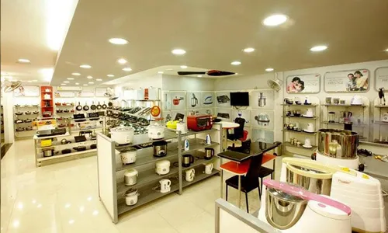
OUR PROJECTS
TTK PRESTIGE
Store is designed as a premium, experience-driven retail space that showcases a full range of kitchen appliances, cookware, and home utility products.
The design language reflects modern minimalism, clear product visibility, strong brand communication, and an organized category.

Slide 13
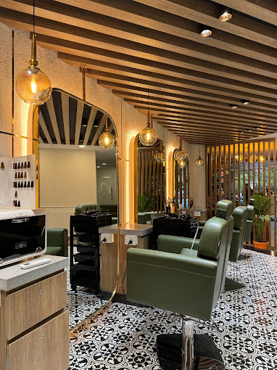
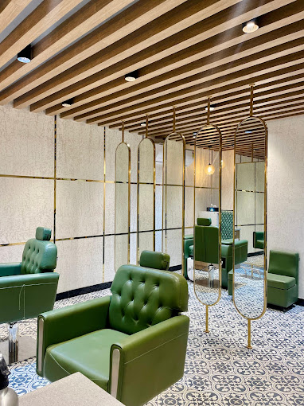
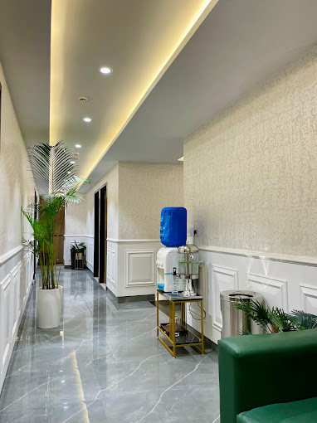
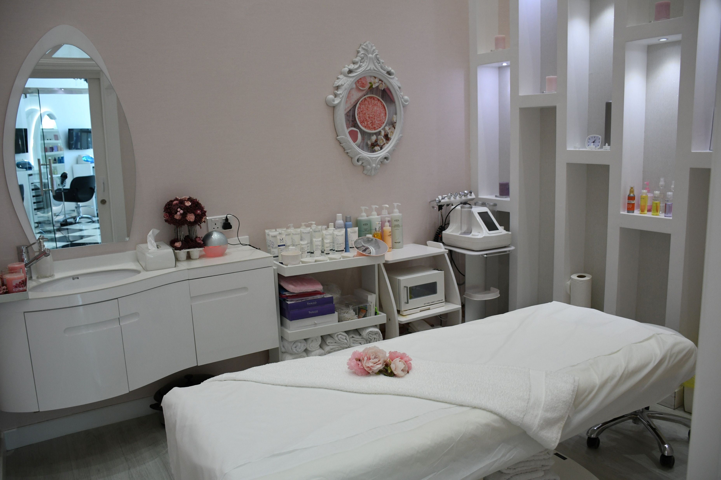
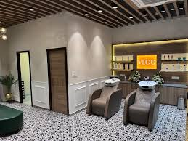
OUR PROJECTS
Wellness and Beauty center.
A dedicated spaces that offer a variety of services to enhance physical health, mental relaxation, and aesthetic appeal.
A wellness center's interior design evokes luxury through a harmonious blend of soft lighting, natural materials, soothing colors, ergonomic furnishings.

Slide 14
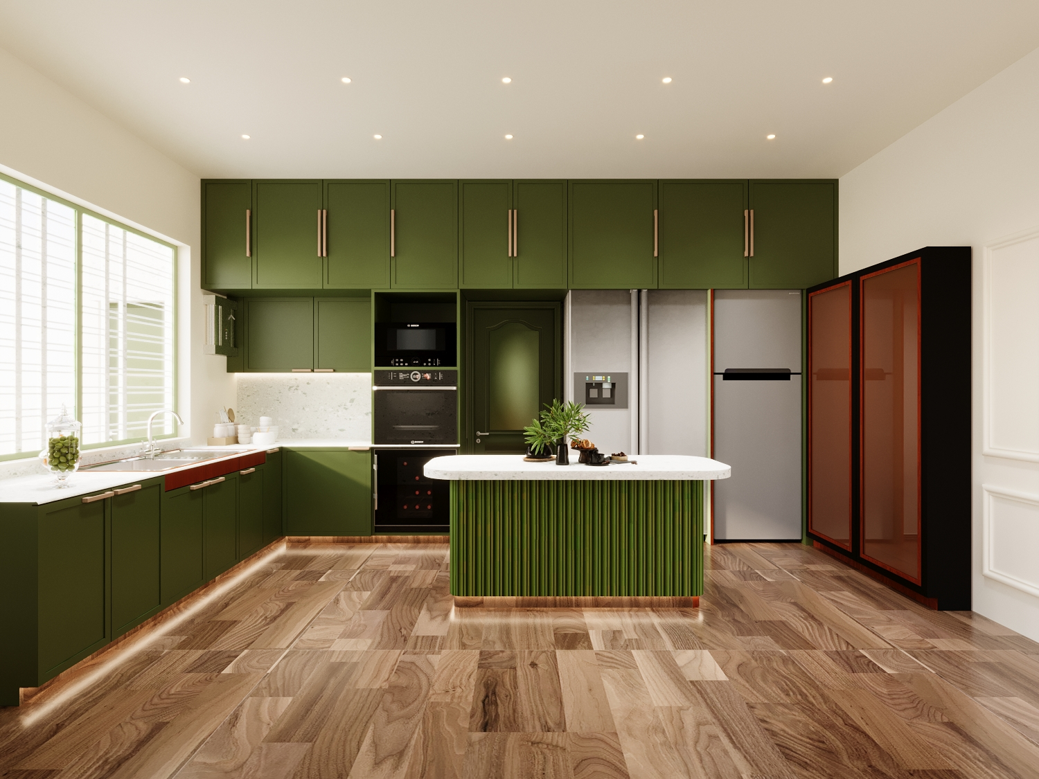
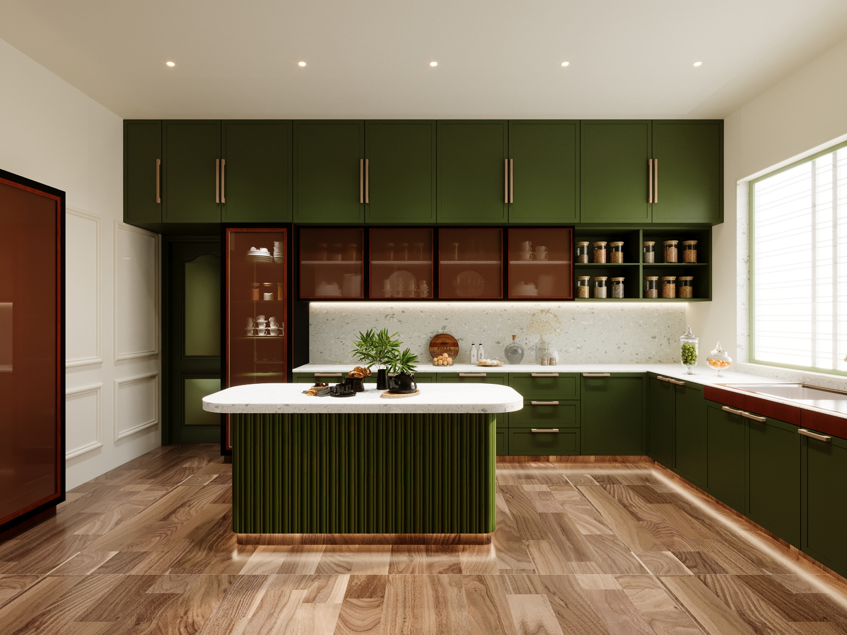
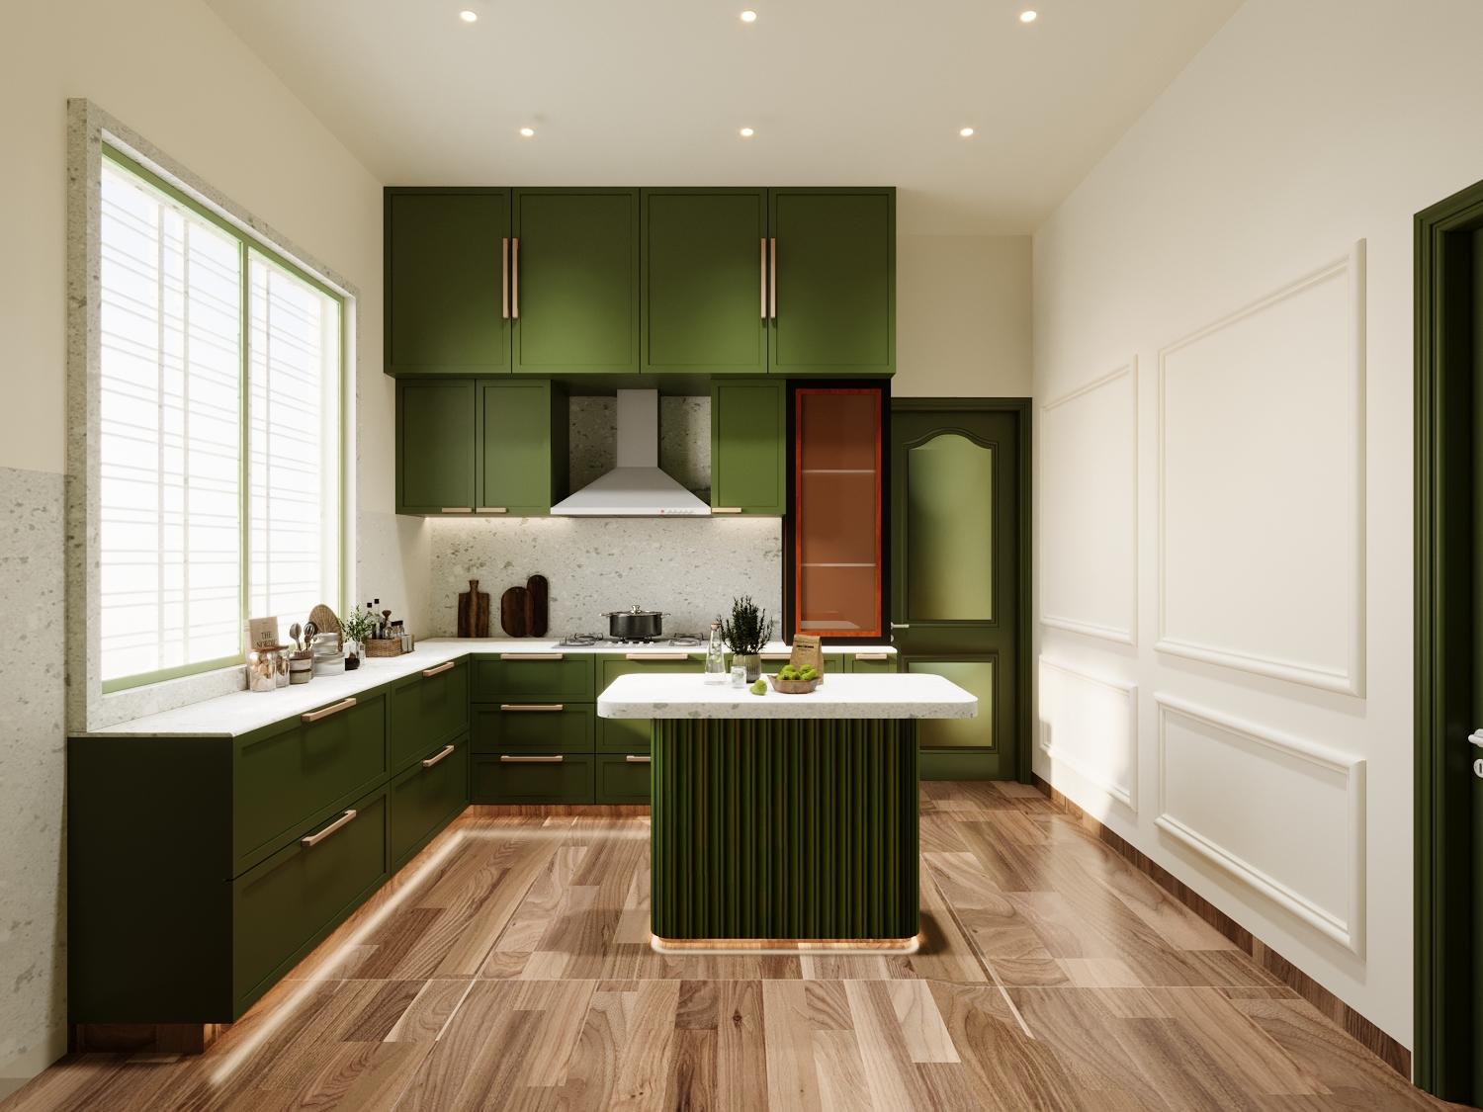
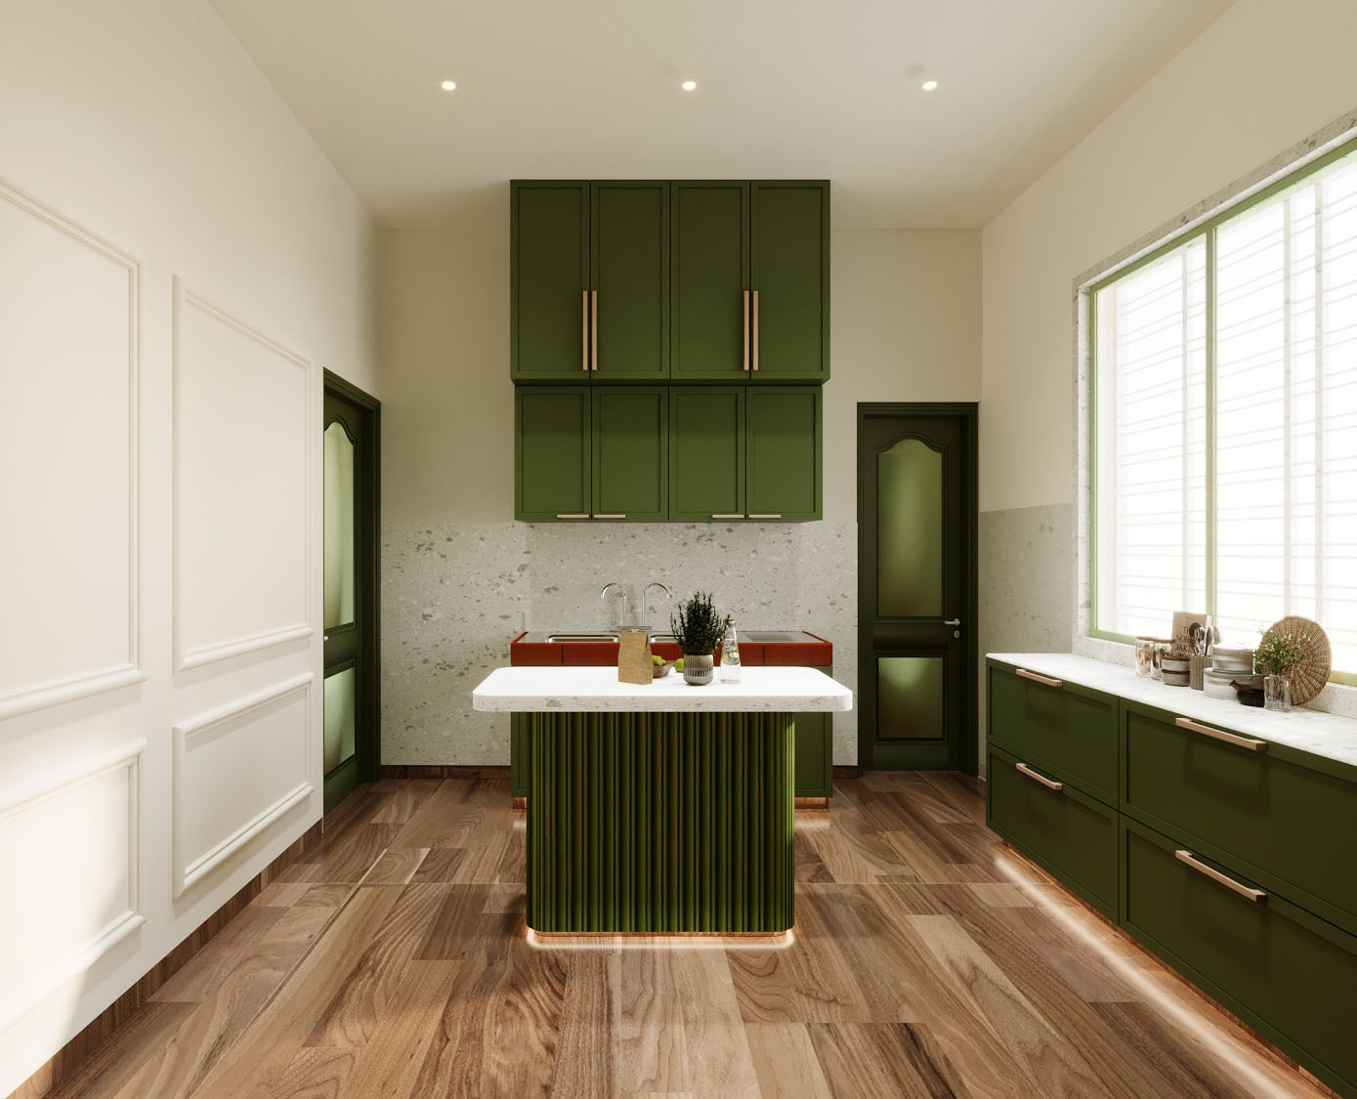
OUR PROJECTS
Residential projects.

Slide 15
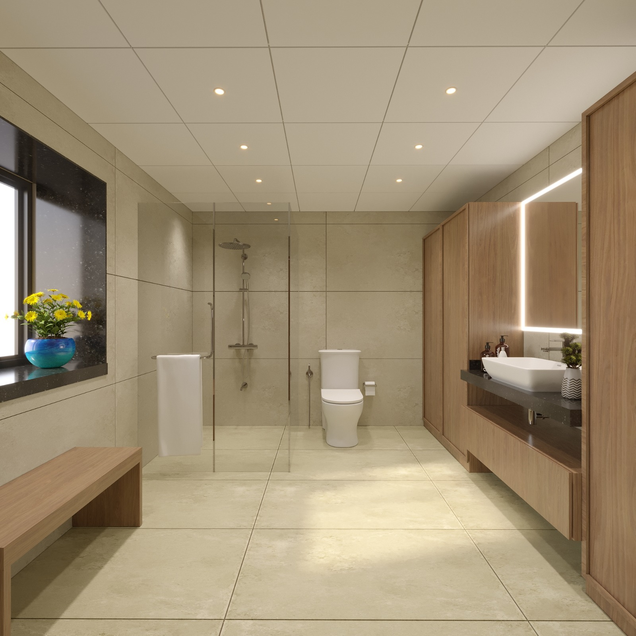
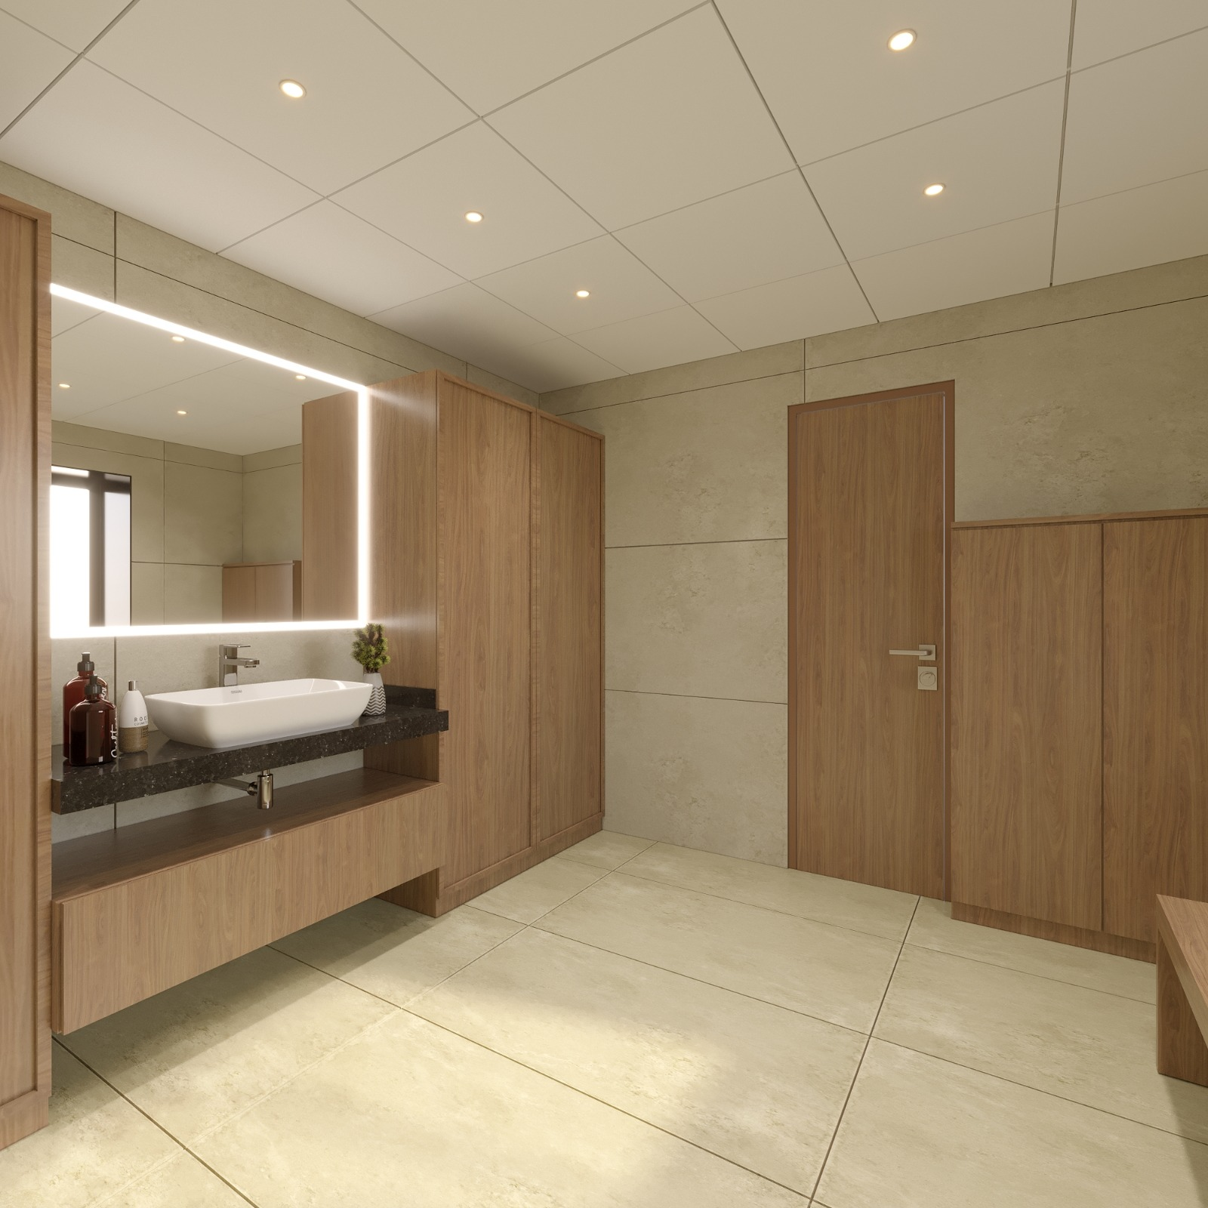
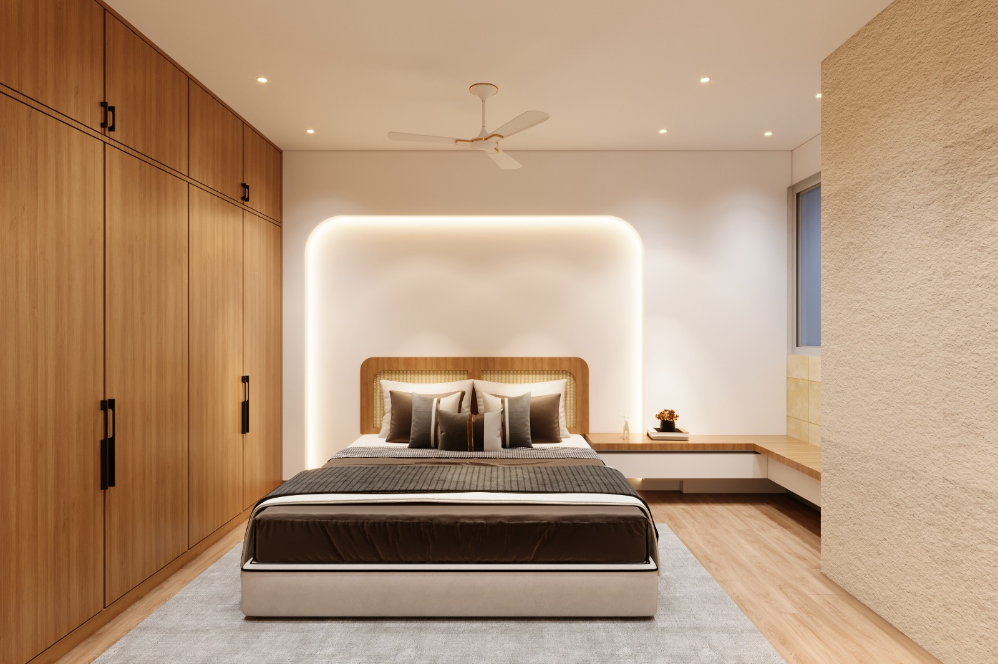
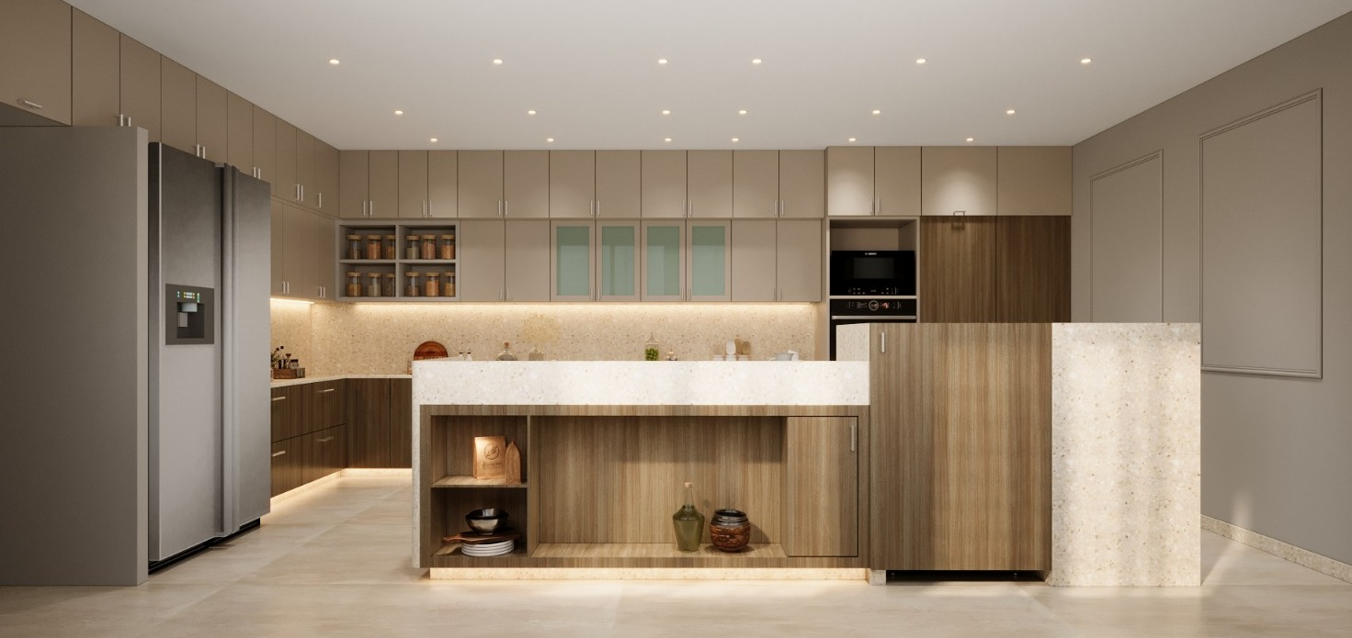
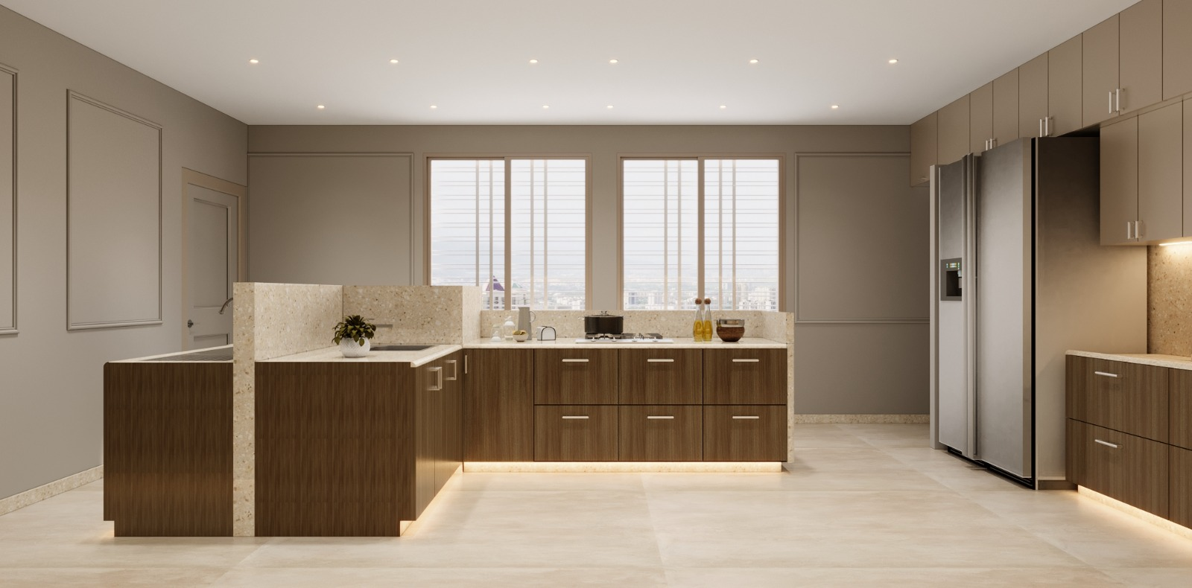
OUR PROJECTS

Slide 16
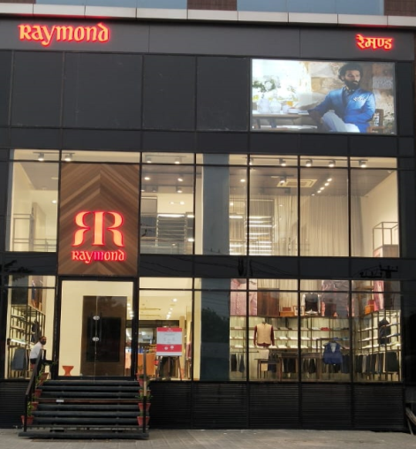
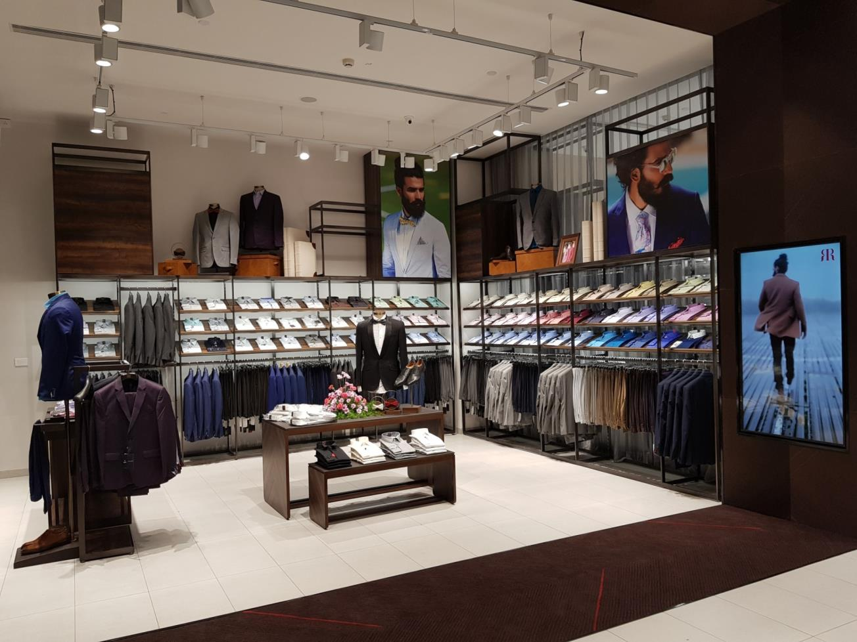
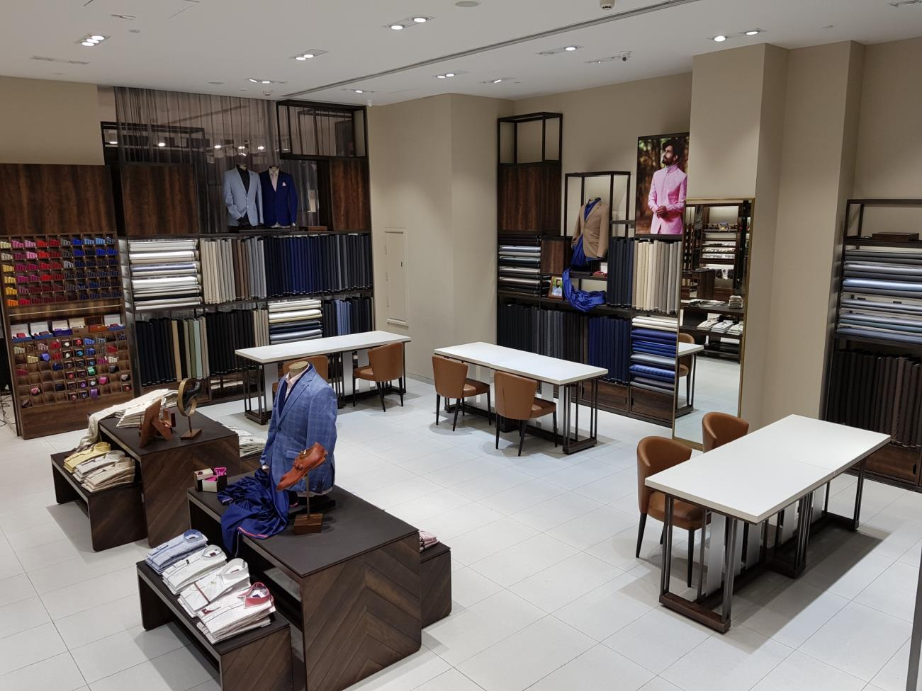
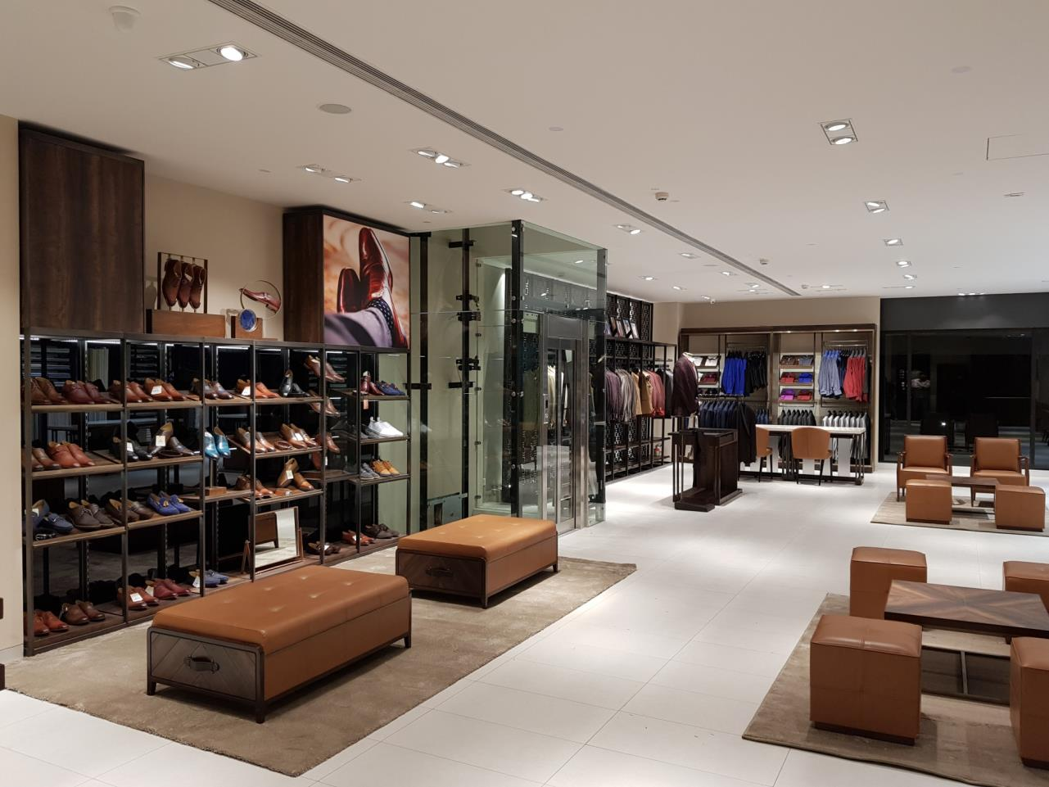
OUR PROJECTS
Raymond.
Store design reflects the brand's ethos, characterized by understated elegance and a harmonious fusion of modern aesthetics and timeless charm.

Slide 17
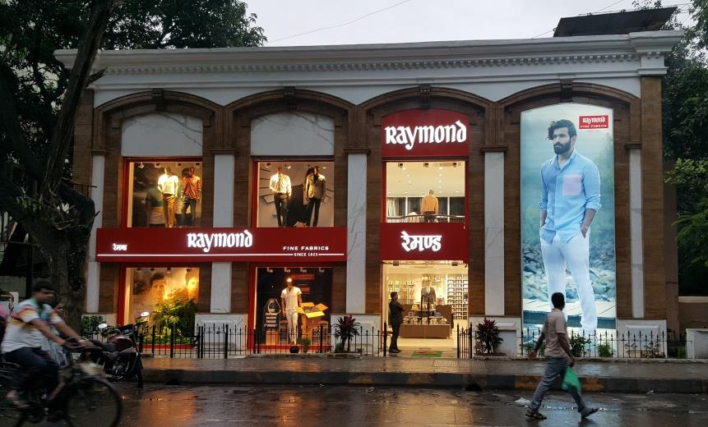
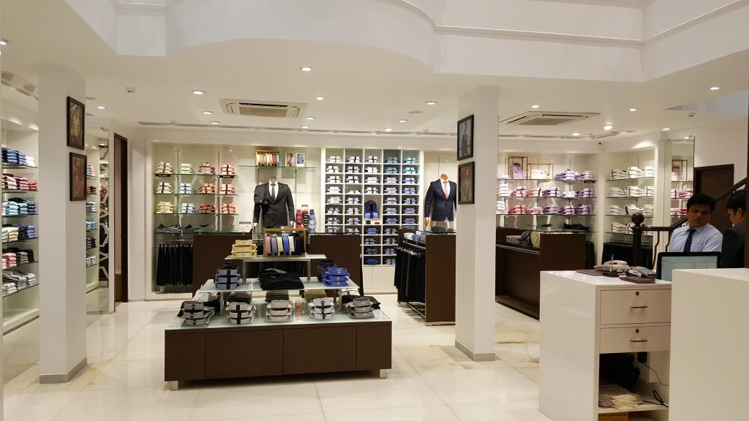
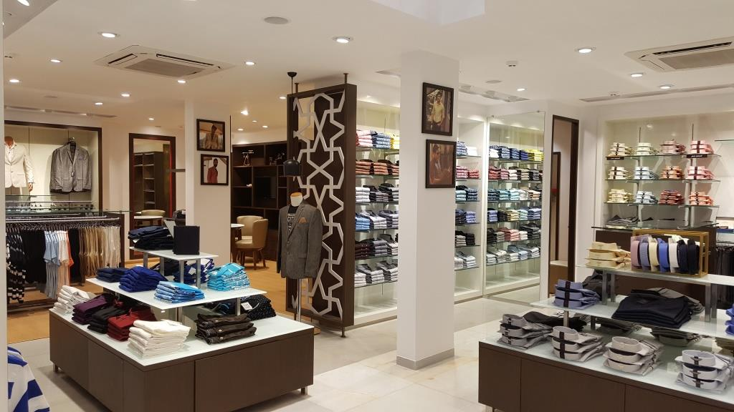
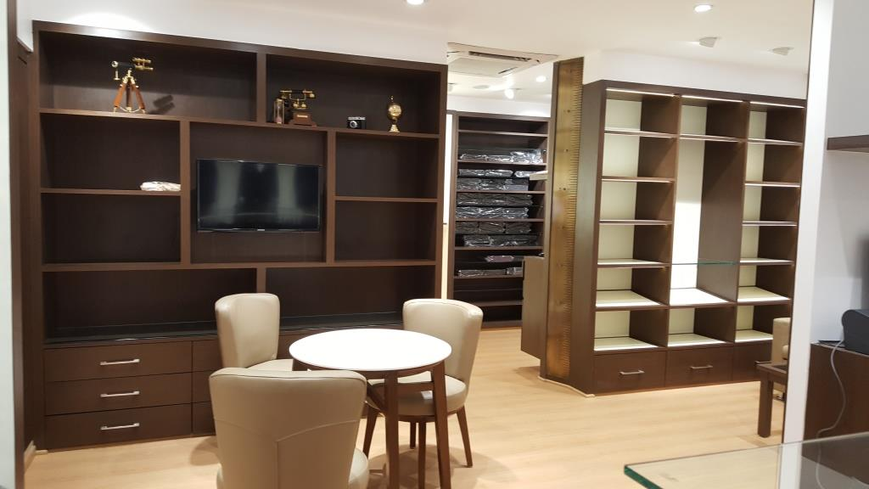
OUR PROJECTS

Slide 18
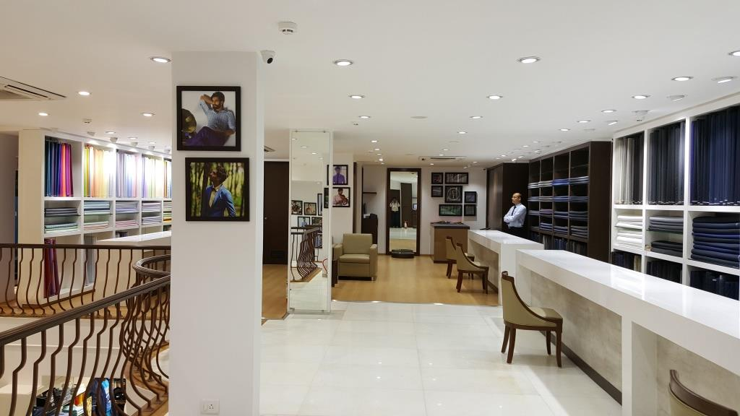
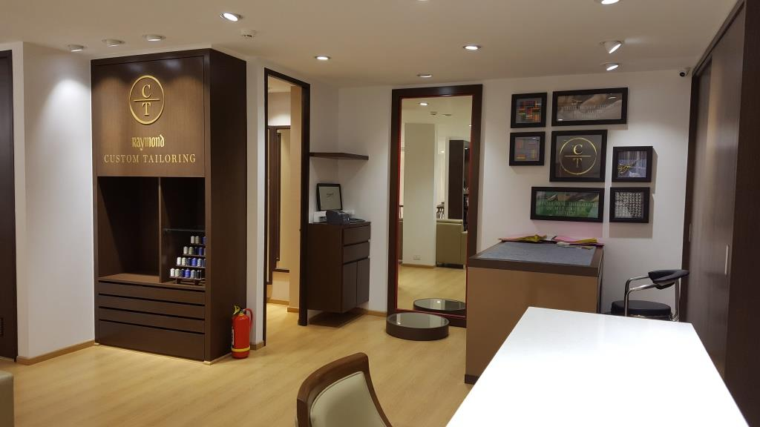


OUR PROJECTS

Slide 19




OUR PROJECTS

Slide 20




OUR PROJECTS
Electronics store.
A Hub, where the future of technology unfolds in a space designed to inspire, engage, and elevate electronic retail experience.
The store designed is clean, with a futuristic touch, creating an atmosphere that reflects the cutting-edge nature of the products on display.

Slide 21




OUR PROJECTS

Slide 22




OUR PROJECTS
ADD ONS –Men and Women Accessory store.
Store design concept creating an inviting ambiance that complements the diverse array of accessories on display.
The store is to enhance the browsing experience with display strategically placed to create distinct sections for different accessory categories.

Slide 23




OUR PROJECTS

Slide 24




OUR CREATIONS
LINEN store design.
Boutique's interior design reflects the brand's ethos, Rich textures, muted tones, and bespoke furnishings create an ambiance that resonates with the discerning taste of brand

Slide 25





OUR CREATIONS

Slide 26




OUR CREATIONS
TAILORING- Concept Design
Store designed wherein art of tailoring meets personalized craftsmanship.
Compact space provides an elegance and impeccable attention to detail where in the craftsman display is exposed to consumers interests.

Slide 27



OUR CREATIONS

Slide 28
Address: Sierra-907, Joyvile, Mulshi Pune, Maharastra - 411057.
Email : delineate07@gmail.com
Contact : 9008304876
THANK YOU

